Slide 1
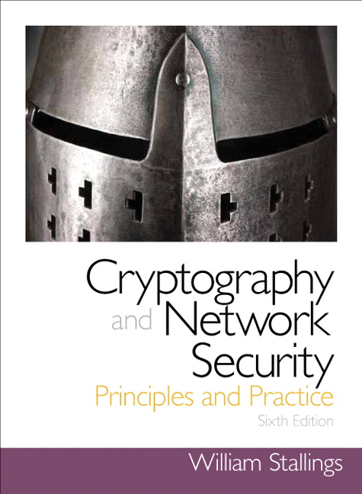
Lecture 3
Chapter 2
Introduction to Number Theory
Dr. Xinyue Zhang
Assistant Professor
Department of Computer Science
Kennesaw State University
Marietta, GA, USA
Notes:
Lecture slides prepared for “Cryptography and Network Security”, 7/e, by William Stallings, Chapter 2 – “Introduction to Number Theory”.

Slide 2
Outline
Review of Lecture 2
Extended Euclidean Algorithm (EEA)
Classical Encryption Techniques
Caesar Cipher
Monoalphabetic Cipher
Polyalphabetic Cipher

Slide 3
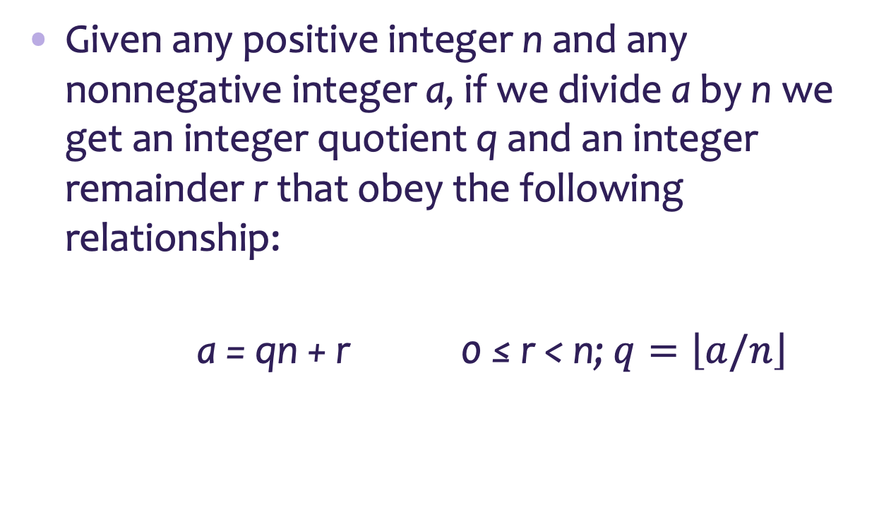
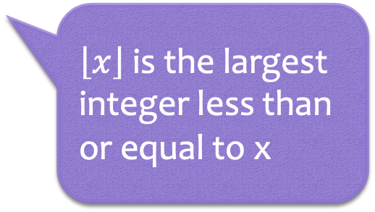
Division Algorithm
Given any positive integer n and any nonnegative integer a, if we divide a by n we get an integer quotient q and an integer remainder r that obey the following relationship:
a = qn + r 0 ≤ r < n; $q=\left\lfloor a/n\right\rfloor$
$\left\lfloor x\right\rfloor$ is the largest integer less than or equal to x
Notes:
Given any positive integer n and any nonnegative integer a, if we divide a by n, we get an integer quotient q and an integer remainder r that obey the following relationship:
a = qn + r, 0 ≤ r < n; q = [a/n] which is referred to as the division algorithm.

Slide 4
Greatest Common Divisor (GCD)
The greatest common divisor of a and b is the largest integer that divides both a and b
We can use the notation gcd(a,b) to mean the greatest common divisor of a and b
We also define gcd(0,0) = 0
Positive integer c is said to be the gcd of a and b if:
c is a divisor of a and b
Any divisor of a and b is a divisor of c
An equivalent definition is:
gcd(a,b) = max[k, such that k | a and k | b]
Notes:
Recall that nonzero b is defined to be a divisor of a if a = mb for some m , where a , b , and
m are integers. We will use the notation gcd(a , b ) to mean the greatest common divisor
of a and b . The greatest common divisor of a and b is the largest integer that divides
both a and b . We also define gcd(0, 0) = 0.
More formally, the positive integer c is said to be the greatest common divisor
of a and b if
1. c is a divisor of a and of b .
2. Any divisor of a and b is a divisor of c .
An equivalent definition is the following:
gcd(a , b ) = max[k , such that k | a and k | b ]

Slide 5
gcd(710, 310) = 10
gcd(310, 710) = 10
Notes:
We now describe an algorithm credited to Euclid for easily finding the greatest
common divisor of two integers (Figure 2.2). This algorithm has broad significance
in cryptography.

Slide 6
Modular Arithmetic
The modulus
If a is an integer and n is a positive integer, we define a mod n to be the remainder when a is divided by n; the integer n is called the modulus
Thus, for any integer a:
a = qn + r 0 ≤ r < n; q = [a/ n]
a = [a/ n] * n + ( a mod n)
11 mod 7 = 4; - 11 mod 7 = 3
Notes:
If a is an integer and n is a positive integer, we define a mod n to be the remainder
when a is divided by n . The integer n is called the modulus . Thus, for any integer a:
a = qn + r 0 ≤ r < n; q = [ a/ n]
a = [a/ n] * n + ( a mod n)

Slide 7


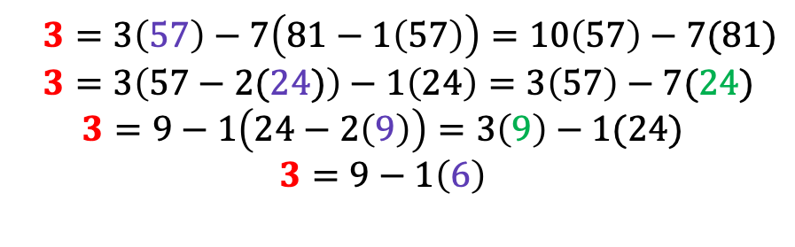
Extended Euclidean Algorithm (EEA)
Finding gcd is not the main application of the Euclidean algorithm.
The extended Euclidean algorithm computes a linear combination of the form:
$$\gcd\left(a,b\right)=pa+sb =d$$
By reversing the steps in the Euclidean Algorithm, we can find these integers p and s.
So we have found $p=−7$and $s=10$.
Finding the gcd of 81 and 57:
$$81=1\left(57\right)+24$$
$$57=2\left(24\right)+9$$
$$24=2\left(9\right)+6$$
$$9=1\left(6\right)+3$$
$$6=2\left(3\right)+0$$
$$3=3\left(57\right)−7\left(81−1\left(57\right)\right)=10\left(57\right)−7(81)$$
$$3=3\left(57−2(24)\right)−1\left(24\right)=3\left(57\right)−7(24)$$
$$3=9−1\left(24−2\left(9\right)\right)=3\left(9\right)−1(24)$$
$$3=9−1\left(6\right)$$

Slide 8
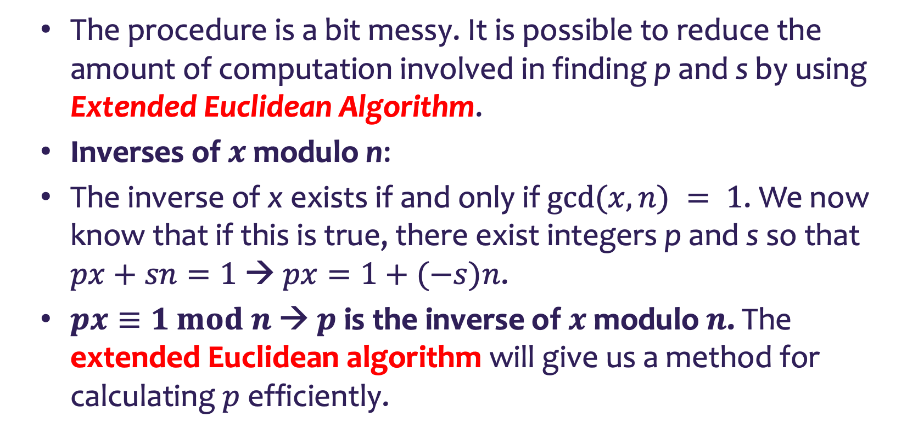
Extended Euclidean Algorithm (EEA)
The procedure is a bit messy. It is possible to reduce the amount of computation involved in finding p and s by using Extended Euclidean Algorithm.
Inverses of $x$ modulo n:
The inverse of x exists if and only if $gcd⁡(x, n) = 1$. We now know that if this is true, there exist integers p and s so that $px+sn=1$ → $px=1+(−s)n$.
$px≡1 mod n$→ $p$ is the inverse of $x$ modulo $n$. The extended Euclidean algorithm will give us a method for calculating $p$ efficiently.

Slide 9
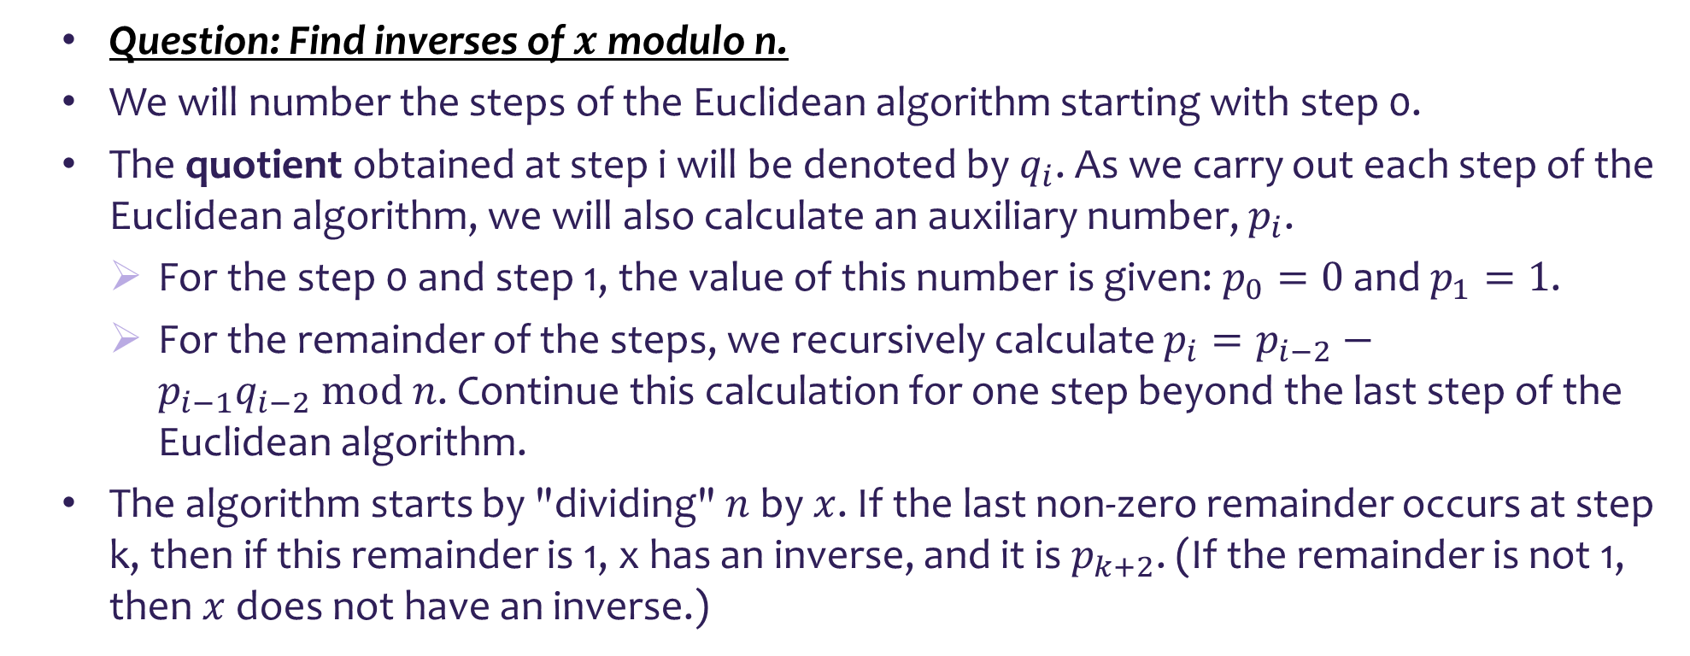
Extended Euclidean Algorithm (EEA)
Question: Find inverses of $x$ modulo n.
We will number the steps of the Euclidean algorithm starting with step 0.
The quotient obtained at step i will be denoted by $q_{i}$. As we carry out each step of the Euclidean algorithm, we will also calculate an auxiliary number, $p_{i}$.
For the step 0 and step 1, the value of this number is given: $p_{0}=0$ and $p_{1}=1$.
For the remainder of the steps, we recursively calculate $p_{i}=p_{i−2}−p_{i−1}q_{i−2} mod n$. Continue this calculation for one step beyond the last step of the Euclidean algorithm.
The algorithm starts by "dividing" $n$ by $x$. If the last non-zero remainder occurs at step k, then if this remainder is 1, x has an inverse, and it is $p_{k+2}$. (If the remainder is not 1, then $x$ does not have an inverse.)

Slide 10

Extended Euclidean Algorithm
Question: Find the inverse of 15 mod 26.
For the step 0 and step 1, the value of this number is given: $p_{0}=0$ and $p_{1}=1$.
For the remainder of the steps, we recursively calculate $p_{i}=p_{i−2}−p_{i−1}q_{i−2} mod n$. Continue this calculation for one step beyond the last step of the Euclidean algorithm.
The algorithm starts by "dividing" $n$ by $x$. If the last non-zero remainder occurs at step k, then if this remainder is 1, x has an inverse, and it is $p_{k+2}$.
We can find that the inverse of 15 mod 26 is 7.
$$15\left(7\right)=105=4\left(26\right)+1≡1 mod 26$$
Step 0: $26=1\left(15\right)+11$
Step 1: $15=1\left(11\right)+4$
Step 2: $11=2\left(4\right)+3$
Step 3: $4=1\left(3\right)+1$
Step 4: $3=3\left(1\right)+0$
$p_{0}=0$
$p_{1}=1$
$p_{2}=p_{0}−p_{1}q_{0} mod n=0−1\left(1\right) mod 26=25$
$p_{3}=1−25\left(1\right) mod 26=−24 mod 26=2$
$p_{4}=25−2\left(2\right) mod 26=21 mod 26=21$
$p_{5}=2−21\left(1\right) mod 26=−19 mod 26=7$

Slide 11
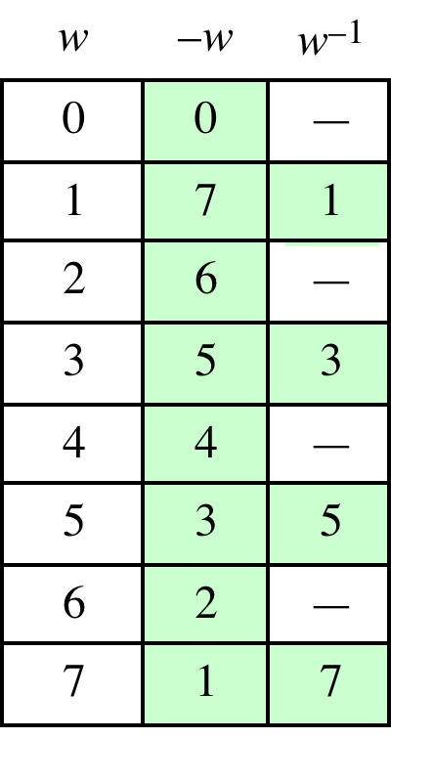
Table 2.2(c) Additive and Multiplicative Inverse Modulo 8
(This table can be found on page 33 in the textbook)
Notes:
As in ordinary addition, there is an additive inverse, or negative, to each integer in
modular arithmetic. In this case, the negative of an integer x is the integer y such
that (x + y ) mod 8 = 0. To find the additive inverse of an integer in the left-hand
column, scan across the corresponding row of the matrix to find the value 0; the
integer at the top of that column is the additive inverse; thus, (2 + 6) mod 8 = 0.

Slide 12
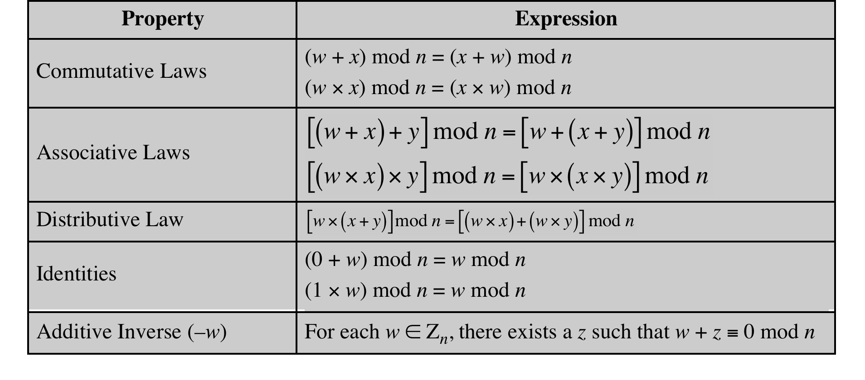
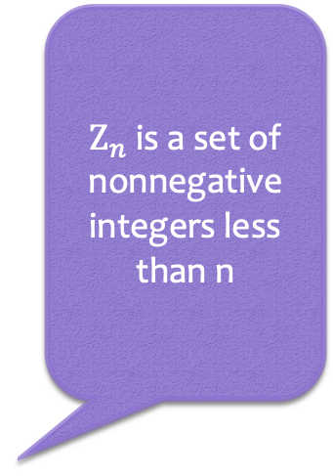
Table 2.3 Properties of Modular Arithmetic for Integers in Z_{n}
$Z_{n}$ is a set of nonnegative integers less than n
(This table can be found on page 34 in the textbook)
Notes:
If we perform modular arithmetic within Z_{n}, the properties shown in Table 2.3 hold for integers in Z_{n} We show in the next section that this implies that Z_{n} is a commutative ring with a multiplicative identity element.
In general, an integer has a multiplicative inverse in Z_{n} if that integer is relatively prime to n. Table 2.2c in the text shows that the integers 1, 3, 5, and 7 have a multiplicative inverse in Z ₈, but 2, 4, and 6 do not.

Slide 13
Chapter 3
Classical Encryption Techniques
Dr. Xinyue Zhang
Assistant Professor
Department of Computer Science
Kennesaw State University
Marietta, GA, USA
Notes:
Symmetric encryption, also referred to as conventional encryption or single-key
encryption, was the only type of encryption in use prior to the development of publickey
encryption in the 1970s. It remains by far the most widely used of the two types
of encryption. Part One examines a number of symmetric ciphers. In this chapter, we
begin with a look at a general model for the symmetric encryption process; this will
enable us to understand the context within which the algorithms are used. Next, we
examine a variety of algorithms in use before the computer era. Finally, we look briefly
at a different approach known as steganography. Chapters 4 and 6 introduce the two
most widely used symmetric cipher: DES and AES.

Slide 14
Definitions
Plaintext
An original message
Ciphertext
The encrypted/coded message
Enciphering/encryption
The process of converting from plaintext to ciphertext
Deciphering/decryption
Restoring the plaintext from the ciphertext
Cryptography
The area of study of the many schemes used for encryption
Cryptographic system/cipher
A scheme
Cryptanalysis
Techniques used for deciphering a message without any knowledge of the enciphering details
Cryptology
The areas of cryptography and cryptanalysis
Notes:
Before beginning, we define some terms. An original message is known as the
plaintext, while the coded message is called the ciphertext. The process of converting
from plaintext to ciphertext is known as enciphering or encryption; restoring the
plaintext from the ciphertext is deciphering or decryption. The many schemes used
for encryption constitute the area of study known as cryptography Such a scheme
is known as a cryptographic system or a cipher. Techniques used for deciphering a
message without any knowledge of the enciphering details fall into the area of cryptanalysis.
Cryptanalysis is what the layperson calls “breaking the code.” The areas of
cryptography and cryptanalysis together are called cryptology.

Slide 15
Notes:
Let us take a closer look at the essential elements of a symmetric encryption
scheme, using Figure 3.2.

Slide 16
Cryptographic Systems
Characterized along three independent dimensions:
The type of operations used for transforming plaintext to ciphertext
Substitution
Transposition/
Permutation
The number of keys used
Symmetric, single-key, secret-key, conventional encryption
Asymmetric, two-key, or public-key encryption
The way in which the plaintext is processed
Block cipher
Stream cipher
Notes:
Cryptographic systems are characterized along three independent dimensions:
1. The type of operations used for transforming plaintext to ciphertext. All
encryption algorithms are based on two general principles: substitution, in
which each element in the plaintext (bit, letter, group of bits or letters) is
mapped into another element, and transposition, in which elements in the
plaintext are rearranged. The fundamental requirement is that no information
be lost (i.e., that all operations are reversible). Most systems, referred to as
product systems , involve multiple stages of substitutions and transpositions.
2. The number of keys used. If both sender and receiver use the same key, the
system is referred to as symmetric, single-key, secret-key, or conventional
encryption. If the sender and receiver use different keys, the system is referred
to as asymmetric, two-key, or public-key encryption.
3. The way in which the plaintext is processed. A block cipher processes the
input one block of elements at a time, producing an output block for each
input block. A stream cipher processes the input elements continuously,
producing output one element at a time, as it goes along.

Slide 17
Cryptanalysis and Brute-Force Attack
Cryptanalysis
Attack relies on the nature of the algorithm plus some knowledge of the general characteristics of the plaintext
Attack exploits the characteristics of the algorithm to attempt to deduce a specific plaintext or to deduce the key being used
Brute-force attack
Attacker tries every possible key on a piece of ciphertext until an intelligible translation into plaintext is obtained
On average, half of all possible keys must be tried to achieve success
Notes:
Typically, the objective of attacking an encryption system is to recover the key in
use rather than simply to recover the plaintext of a single ciphertext. There are two
general approaches to attacking a conventional encryption scheme:
• Cryptanalysis: Cryptanalytic attacks rely on the nature of the algorithm plus
perhaps some knowledge of the general characteristics of the plaintext or
even some sample plaintext–ciphertext pairs. This type of attack exploits the
characteristics of the algorithm to attempt to deduce a specific plaintext or to
deduce the key being used.
• Brute-force attack: The attacker tries every possible key on a piece of ciphertext
until an intelligible translation into plaintext is obtained. On average, half
of all possible keys must be tried to achieve success.
If either type of attack succeeds in deducing the key, the effect is catastrophic:
All future and past messages encrypted with that key are compromised.

Slide 18
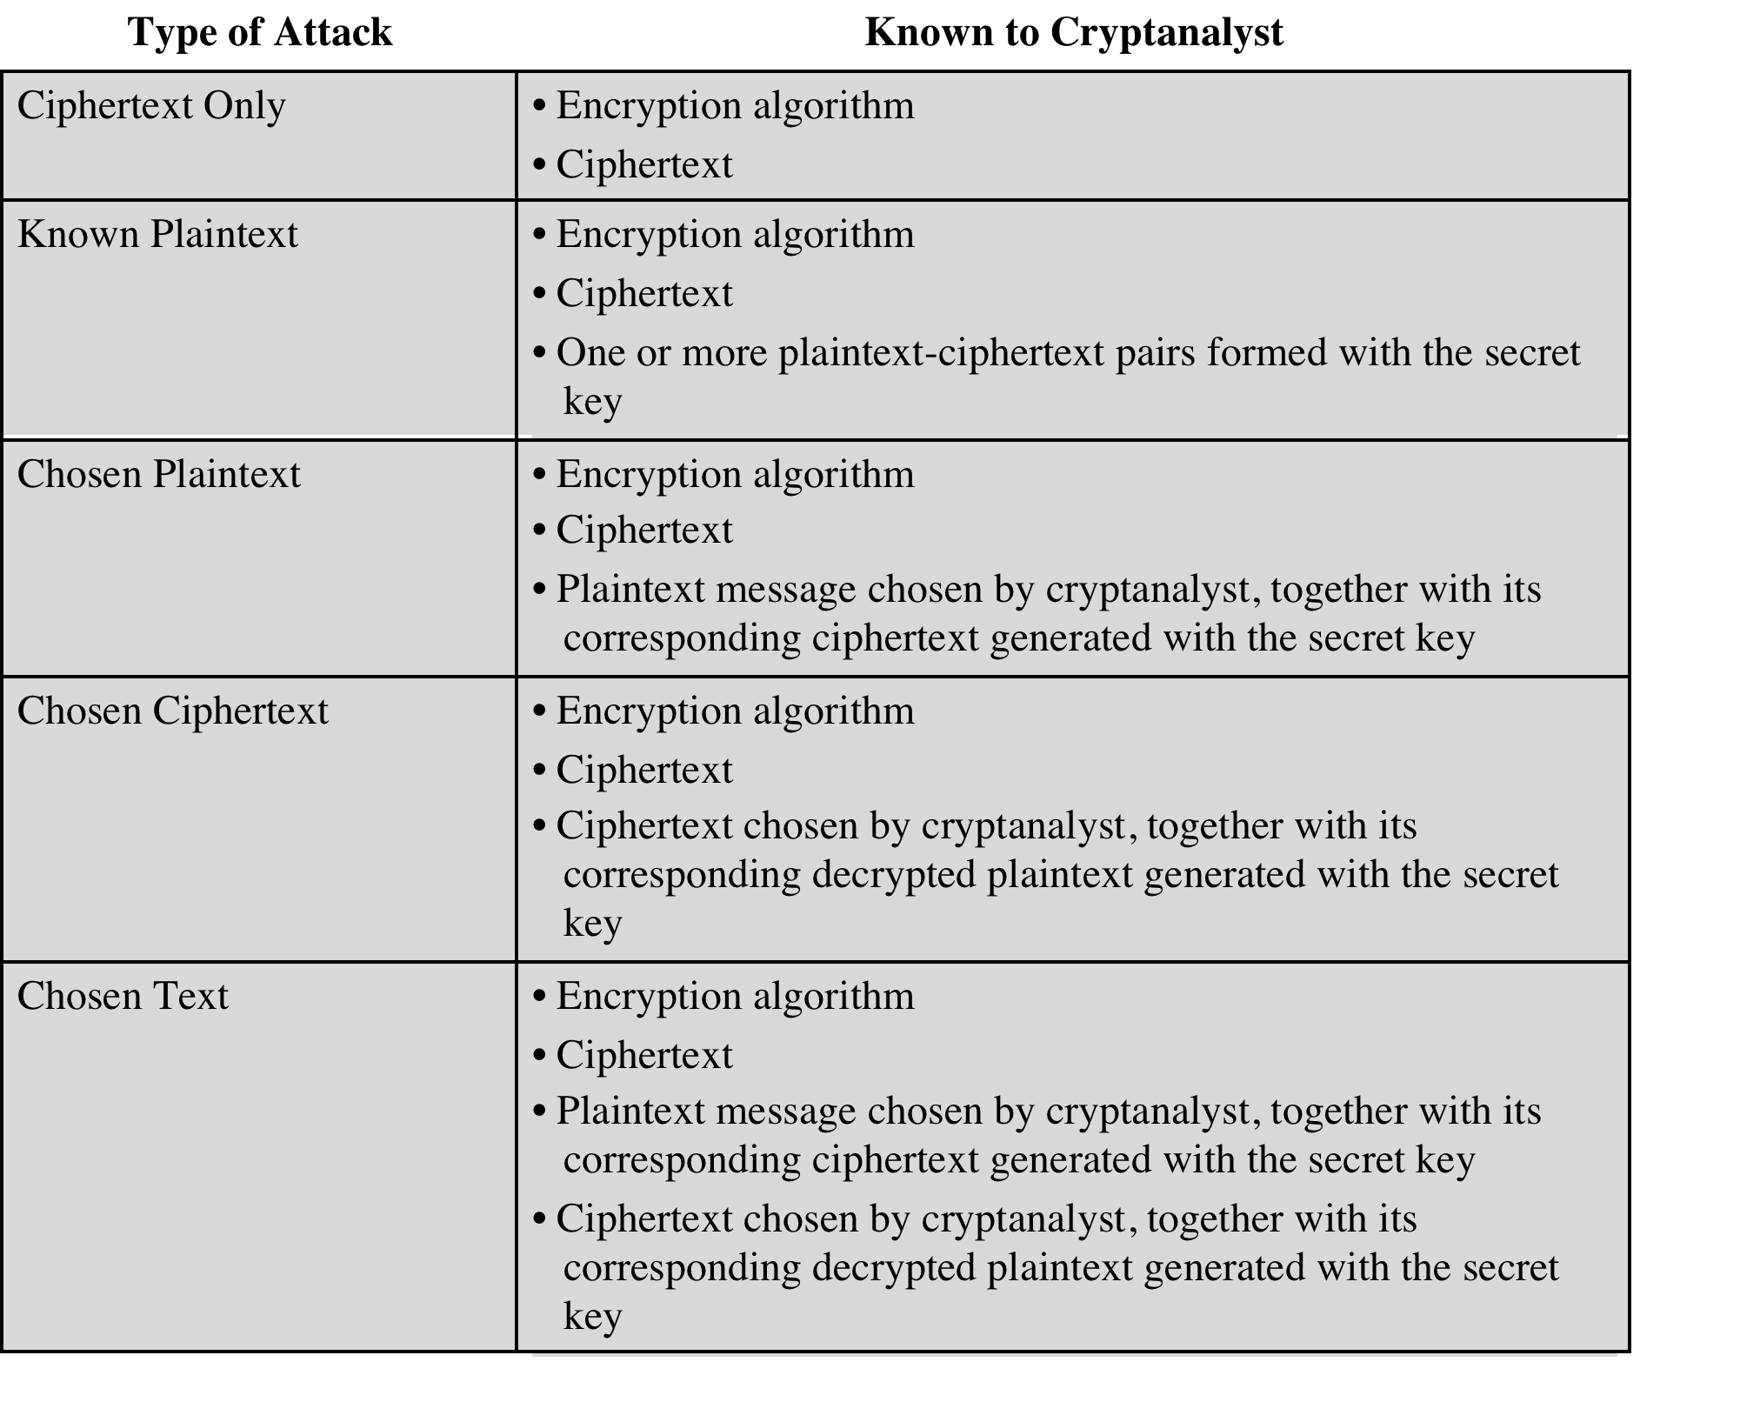
Table 3.1 Types of Attacks on Encrypted Messages
(Table is on page 68 in the textbook)
Notes:
Table 3.1 summarizes the various types of cryptanalytic attacks based on the
amount of information known to the cryptanalyst. The most difficult problem is
presented when all that is available is the ciphertext only . In some cases, not even
the encryption algorithm is known, but in general, we can assume that the opponent
does know the algorithm used for encryption. One possible attack under these
circumstances is the brute-force approach of trying all possible keys. If the key space
is very large, this becomes impractical. Thus, the opponent must rely on an analysis
of the ciphertext itself, generally applying various statistical tests to it. To use this
approach, the opponent must have some general idea of the type of plaintext that
is concealed, such as English or French text, an EXE file, a Java source listing, an
accounting file, and so on.
The ciphertext-only attack is the easiest to defend against because the
opponent has the least amount of information to work with. In many cases, however,
the analyst has more information. The analyst may be able to capture one or more
plaintext messages as well as their encryptions. Or the analyst may know that certain
plaintext patterns will appear in a message. For example, a file that is encoded in the
Postscript format always begins with the same pattern, or there may be a standardized
header or banner to an electronic funds transfer message, and so on. All these are
examples of known plaintext . With this knowledge, the analyst may be able to deduce
the key on the basis of the way in which the known plaintext is transformed.
Closely related to the known-plaintext attack is what might be referred to as a
probable-word attack. If the opponent is working with the encryption of some general
prose message, he or she may have little knowledge of what is in the message.
However, if the opponent is after some very specific information, then parts of the
message may be known. For example, if an entire accounting file is being transmitted,
the opponent may know the placement of certain key words in the header of the
file. As another example, the source code for a program developed by Corporation
X might include a copyright statement in some standardized position.
If the analyst is able somehow to get the source system to insert into the system
a message chosen by the analyst, then a chosen-plaintext attack is possible. In general,
if the analyst is able to choose the messages to encrypt, the analyst may deliberately
pick patterns that can be expected to reveal the structure of the key.
Table 3.1 lists two other types of attack: chosen ciphertext and chosen text.
These are less commonly employed as cryptanalytic techniques but are nevertheless
possible avenues of attack.

Slide 19
Brute-Force Attack
Involves trying every possible key until an intelligible translation of the ciphertext into plaintext is obtained
On average, half of all possible keys must be tried to achieve success
To supplement the brute-force approach, some degree of knowledge about the expected plaintext is needed, and some means of automatically distinguishing plaintext from garble is also needed
Notes:
A brute-force attack involves trying every possible key until an intelligible
translation of the ciphertext into plaintext is obtained. On average, half of all possible
keys must be tried to achieve success. That is, if there are X different keys, on
average an attacker would discover the actual key after X/2 tries. It is important to
note that there is more to a brute-force attack than simply running through all possible
keys. Unless known plaintext is provided, the analyst must be able to recognize
plaintext as plaintext. If the message is just plain text in English, then the result pops
out easily, although the task of recognizing English would have to be automated. If
the text message has been compressed before encryption, then recognition is more
difficult. And if the message is some more general type of data, such as a numerical
file, and this has been compressed, the problem becomes even more difficult to
automate. Thus, to supplement the brute-force approach, some degree of knowledge
about the expected plaintext is needed, and some means of automatically
distinguishing plaintext from garble is also needed.

Slide 20
Encryption Scheme Security
Unconditionally secure
No matter how much time an opponent has, it is impossible for him or her to decrypt the ciphertext simply because the required information is not there
Computationally secure
The cost of breaking the cipher exceeds the value of the encrypted information
The time required to break the cipher exceeds the useful lifetime of the information
Notes:
Two more definitions are worthy of note. An encryption scheme is unconditionally
secure if the ciphertext generated by the scheme does not contain enough
information to determine uniquely the corresponding plaintext, no matter how
much ciphertext is available. That is, no matter how much time an opponent has, it
is impossible for him or her to decrypt the ciphertext simply because the required
information is not there. With the exception of a scheme known as the one-time pad
(described later in this chapter), there is no encryption algorithm that is unconditionally
secure. Therefore, all that the users of an encryption algorithm can strive
for is an algorithm that meets one or both of the following criteria:
• The cost of breaking the cipher exceeds the value of the encrypted information.
• The time required to break the cipher exceeds the useful lifetime of the
information.
An encryption scheme is said to be computationally secure if either of the
foregoing two criteria are met. Unfortunately, it is very difficult to estimate the
amount of effort required to cryptanalyze ciphertext successfully.
All forms of cryptanalysis for symmetric encryption schemes are designed
to exploit the fact that traces of structure or pattern in the plaintext may survive
encryption and be discernible in the ciphertext. This will become clear as we examine
various symmetric encryption schemes in this chapter. We will see in Part Three
that cryptanalysis for public-key schemes proceeds from a fundamentally different
premise, namely, that the mathematical properties of the pair of keys may make it
possible for one of the two keys to be deduced from the other.

Slide 21
Strong Encryption
The term strong encryption refers to encryption schemes that make it impractically difficult for unauthorized persons or systems to gain access to plaintext that has been encrypted
Properties that make an encryption algorithm strong are:
Appropriate choice of cryptographic algorithm
Use of sufficiently long key lengths
Appropriate choice of protocols
A well-engineered implementation
Absence of deliberately introduced hidden flaws
Notes:
For users, security managers, and organization executives, there is a requirement for strong encryption to protect data. The term strong encryption is an imprecise one, but in general terms, it refers to encryption schemes that make it impractically difficult for unauthorized persons or systems to gain access to plaintext that has been encrypted. [NAS18] lists the following properties that make an encryption algorithm strong: appropriate choice of cryptographic algorithm, use of sufficiently long key lengths, appropriate choice of protocols, a well-engineered implementation, and the absence of deliberately introduced hidden flaws. The first two factors relate to cryptanalysis, discussed in this section, and the third factor relates to the discussion in Part Six. The last two factors are beyond the scope of this book.

Slide 22
Substitution Technique
the letters of plaintext are replaced by other letters or by numbers or symbols
If the plaintext is viewed as a sequence of bits, then substitution involves replacing plaintext bit patterns with ciphertext bit patterns
Notes:
The two basic building blocks of all encryption techniques are substitution
and transposition. We examine these in the next two sections. Finally, we discuss a
system that combines both substitution and transposition.
A substitution technique is one in which the letters of plaintext are replaced by
other letters or by numbers or symbols. If the plaintext is viewed as a sequence of bits,
then substitution involves replacing plaintext bit patterns with ciphertext bit patterns.

Slide 23

Caesar Cipher
Simplest and earliest known use of a substitution cipher
Used by Julius Caesar
Involves replacing each letter of the alphabet with the letter standing three places further down the alphabet
Alphabet is wrapped around so that the letter following Z is A
plain: meet me after the toga party
cipher: PHHW PH DIWHU WKH WRJD SDUWB
Notes:
The earliest known, and the simplest, use of a substitution cipher was by Julius
Caesar. The Caesar cipher involves replacing each letter of the alphabet with the
letter standing three places further down the alphabet.

Slide 24
Caesar Cipher Algorithm
Can define transformation as:
a b c d e f g h i j k l m n o p q r s t u v w x y z
D E F G H I J K L M N O P Q R S T U V W X Y Z A B C
Mathematically give each letter a number
a b c d e f g h i j k l m n o p q r s t u v w x y z
0 1 2 3 4 5 6 7 8 9 10 11 12 13 14 15 16 17 18 19 20 21 22 23 24 25
Algorithm can be expressed as:
c = E(3, p) = (p + 3) mod (26)
A shift may be of any amount, so that the general Caesar algorithm is:
C = E(k , p ) = (p + k ) mod 26
Where k takes on a value in the range 1 to 25; the decryption algorithm is simply:
p = D(k , C ) = (C - k ) mod 26
Notes:
Note that the alphabet is wrapped around, so that the letter following Z is A.
An algorithm can be expressed as follows. For each plaintext letter p , substitute
the ciphertext letter C

Slide 25
Figure 3.3
Brute-Force Cryptanalysis
of
Caesar Cipher
(This chart can be found on page 71 in the textbook)
Notes:
If it is known that a given ciphertext is a Caesar cipher, then a brute-force
cryptanalysis is easily performed: simply try all the 25 possible keys. Figure 3.3
shows the results of applying this strategy to the example ciphertext. In this case, the
plaintext leaps out as occupying the third line.
Three important characteristics of this problem enabled us to use a brute-force
cryptanalysis:
1. The encryption and decryption algorithms are known.
2. There are only 25 keys to try.
3. The language of the plaintext is known and easily recognizable.

Slide 26
Monoalphabetic Cipher
Permutation
Of a finite set of elements S is an ordered sequence of all the elements of S , with each element appearing exactly once
If the “cipher” line can be any permutation of the 26 alphabetic characters, then there are 26! > 4 x 10²⁶ possible keys
This is 10 orders of magnitude greater than the key space for DES
Approach is referred to as a monoalphabetic substitution cipher because a single cipher alphabet is used per message
Notes:
With only 25 possible keys, the Caesar cipher is far from secure. A dramatic increase
in the key space can be achieved by allowing an arbitrary substitution. Before proceeding,
we define the term permutation . A permutation of a finite set of elements S
is an ordered sequence of all the elements of S, with each element appearing exactly
once.
For example, if S = {a, b, c}, there are six permutations of S :
abc, acb, bac, bca, cab, cba
In general, there are n ! permutations of a set of n elements, because the first
element can be chosen in one of n ways, the second in n - 1 ways, the third in n - 2
ways, and so on.
If, instead, the “cipher” line can be any permutation of the 26 alphabetic characters,
then there are 26! or greater than 4 * 10²⁶ possible keys. This is 10 orders of magnitude
greater than the key space for DES and would seem to eliminate brute-force
techniques for cryptanalysis. Such an approach is referred to as a monoalphabetic
substitution cipher, because a single cipher alphabet (mapping from plain alphabet
to cipher alphabet) is used per message.

Slide 27
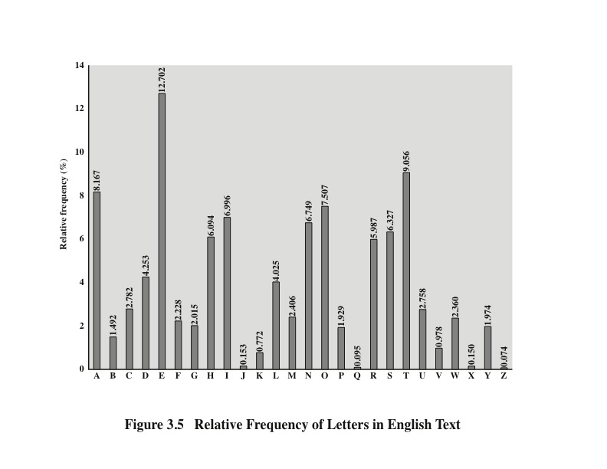
Notes:
There is, however, another line of attack. If the cryptanalyst knows the nature
of the plaintext (e.g., noncompressed English text), then the analyst can exploit the
regularities of the language. To see how such a cryptanalysis might proceed, we give
a partial example here that is adapted from one in [SINK09]. The ciphertext to be
solved is
UZQSOVUOHXMOPVGPOZPEVSGZWSZOPFPESXUDBMETSXAIZ
VUEPHZHMDZSHZOWSFPAPPDTSVPQUZWYMXUZUHSX
EPYEPOPDZSZUFPOMBZWPFUPZHMDJUDTMOHMQ
As a first step, the relative frequency of the letters can be determined and
compared to a standard frequency distribution for English, such as is shown in
Figure 3.5 (based on [LEWA00]). If the message were long enough, this technique
alone might be sufficient, but because this is a relatively short message, we cannot
expect an exact match. In any case, the relative frequencies of the letters in the
ciphertext (in percentages) are as follows:
P 13.33 H 5.83 F 3.33 B 1.67 C 0.00
Z 11.67 D 5.00 W 3.33 G 1.67 K 0.00
S 8.33 E 5.00 Q 2.50 Y 1.67 L 0.00
U 8.33 V 4.17 T 2.50 I 0.83 N 0.00
O 7.50 X 4.17 A 1.67 J 0.83 R 0.00
M 6.67
Comparing this breakdown with Figure 3.5, it seems likely that cipher letters P
and Z are the equivalents of plain letters e and t, but it is not certain which is which.
The letters S, U, O, M, and H are all of relatively high frequency and probably correspond
to plain letters from the set {a, h, i, n, o, r, s}. The letters with the lowest
frequencies (namely, A, B, G, Y, I, J) are likely included in the set {b, j, k, q, v, x, z}.
There are a number of ways to proceed at this point. We could make some tentative
assignments and start to fill in the plaintext to see if it looks like a reasonable
“skeleton” of a message. A more systematic approach is to look for other regularities.
For example, certain words may be known to be in the text. Or we could look for
repeating sequences of cipher letters and try to deduce their plaintext equivalents.

Slide 28
Monoalphabetic Ciphers
Easy to break because they reflect the frequency data of the original alphabet
Countermeasure: to provide multiple substitutes (homophones) for a single letter
Digram
Two-letter combination
Most common is th
Trigram
Three-letter combination
Most frequent is the
Notes:
A powerful tool is to look at the frequency of two-letter combinations, known
as digrams . A table similar to Figure 3.5 could be drawn up showing the relative frequency
of digrams. The most common such digram is th. In our ciphertext, the most
common digram is ZW, which appears three times. So we make the correspondence
of Z with t and W with h. Then, by our earlier hypothesis, we can equate P with e.
Now notice that the sequence ZWP appears in the ciphertext, and we can translate
that sequence as “the.” This is the most frequent trigram (three-letter combination)
in English, which seems to indicate that we are on the right track.
Next, notice the sequence ZWSZ in the first line. We do not know that these
four letters form a complete word, but if they do, it is of the form th_t. If so, S
equates with a.
So far, then, we have
UZQSOVUOHXMOPVGPOZPEVSGZWSZOPFPESXUDBMETSXAIZ
t a e e te a that e e a a
VUEPHZHMDZSHZOWSFPAPPDTSVPQUZWYMXUZUHSX
e t ta t ha e ee a e th t a
EPYEPOPDZSZUFPOMBZWPFUPZHMDJUDTMOHMQ
e e e tat e the t
Only four letters have been identified, but already we have quite a bit of the
message. Continued analysis of frequencies plus trial and error should easily yield a
solution from this point. The complete plaintext, with spaces added between words,
follows:
it was disclosed yesterday that several informal but
direct contacts have been made with political
representatives of the Viet cong in Moscow
Monoalphabetic ciphers are easy to break because they reflect the frequency
data of the original alphabet. A countermeasure is to provide multiple substitutes,
known as homophones, for a single letter. For example, the letter e could be assigned
a number of different cipher symbols, such as 16, 74, 35, and 21, with each
homophone assigned to a letter in rotation or randomly. If the number of symbols
assigned to each letter is proportional to the relative frequency of that letter, then
single-letter frequency information is completely obliterated. The great mathematician
Carl Friedrich Gauss believed that he had devised an unbreakable cipher using
homophones. However, even with homophones, each element of plaintext affects
only one element of ciphertext, and multiple-letter patterns (e.g., digram frequencies)
still survive in the ciphertext, making cryptanalysis relatively straightforward.
Two principal methods are used in substitution ciphers to lessen the extent to
which the structure of the plaintext survives in the ciphertext: One approach is to
encrypt multiple letters of plaintext, and the other is to use multiple cipher alphabets.
We briefly examine each.

Slide 29
Playfair Cipher
Best-known multiple-letter encryption cipher
Treats digrams in the plaintext as single units and translates these units into ciphertext digrams
Based on the use of a 5 x 5 matrix of letters constructed using a keyword
Invented by British scientist Sir Charles Wheatstone in 1854
Used as the standard field system by the British Army in World War I and the U.S. Army and other Allied forces during World War II
Notes:
The best-known multiple-letter encryption cipher is the Playfair, which treats
digrams in the plaintext as single units and translates these units into ciphertext
Digrams.
The Playfair algorithm is based on the use of a 5 * 5 matrix of letters constructed
using a keyword.

Slide 30
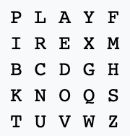
Playfair Key Matrix
Playfair example as “keyword”
The table:
i/j interchangeable
Plaintext: Hide the gold in the tree stump
HI DE TH EG OL DI NT HE TR EX ES TU MP
Notes:
In this case, the keyword is monarchy . The matrix is constructed by filling
in the letters of the keyword (minus duplicates) from left to right and from top to
bottom, and then filling in the remainder of the matrix with the remaining letters in
alphabetic order. The letters I and J count as one letter. Plaintext is encrypted two
letters at a time, according to the following rules:
1. Repeating plaintext letters that are in the same pair are separated with a filler
letter, such as x, so that balloon would be treated as ba lx lo on.
2. Two plaintext letters that fall in the same row of the matrix are each replaced
by the letter to the right, with the first element of the row circularly following
the last. For example, ar is encrypted as RM.
3. Two plaintext letters that fall in the same column are each replaced by the
letter beneath, with the top element of the column circularly following the last.
For example, mu is encrypted as CM.
4. Otherwise, each plaintext letter in a pair is replaced by the letter that lies in
its own row and the column occupied by the other plaintext letter. Thus, hs
becomes BP and ea becomes IM (or JM, as the encipherer wishes).
The Playfair cipher is a great advance over simple monoalphabetic ciphers.
For one thing, whereas there are only 26 letters, there are 26 * 26 = 676 digrams, so
that identification of individual digrams is more difficult. Furthermore, the relative
frequencies of individual letters exhibit a much greater range than that of digrams,
making frequency analysis much more difficult. For these reasons, the Playfair
cipher was for a long time considered unbreakable. It was used as the standard field
system by the British Army in World War I and still enjoyed considerable use by the
U.S. Army and other Allied forces during World War II.
Despite this level of confidence in its security, the Playfair cipher is relatively
easy to break, because it still leaves much of the structure of the plaintext language
intact. A few hundred letters of ciphertext are generally sufficient.

Slide 31
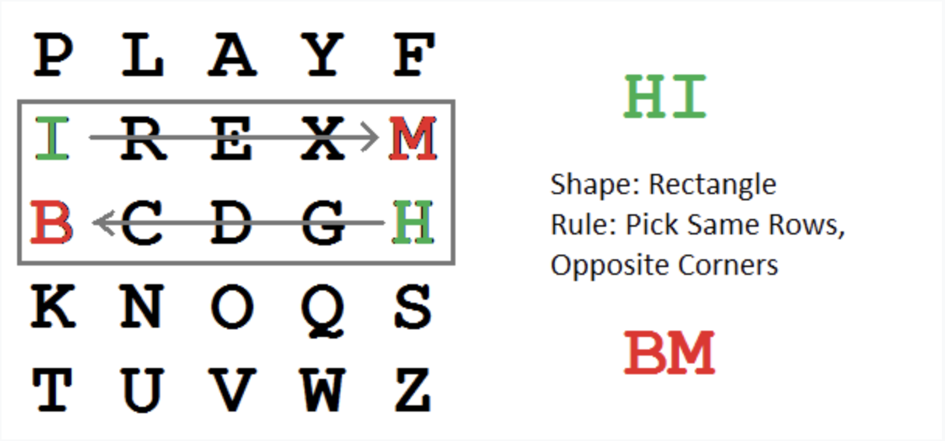
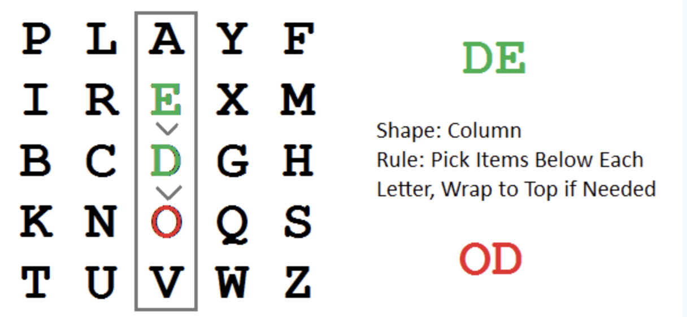
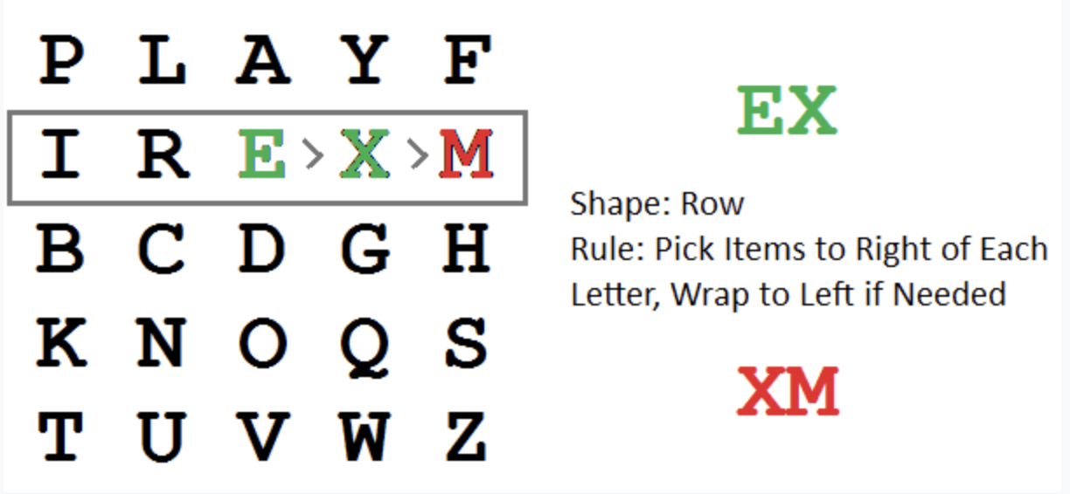
Playfair Key Matrix
HI DE TH EG OL DI NT HE TR EX ES TU MP

Slide 32
Polyalphabetic Ciphers
Polyalphabetic substitution cipher
Improves on the simple monoalphabetic technique by using different monoalphabetic substitutions as one proceeds through the plaintext message
All these techniques have the following features in common:
A set of related monoalphabetic substitution rules is used
A key determines which particular rule is chosen for a given transformation
Notes:
Another way to improve on the simple monoalphabetic technique is to use different
monoalphabetic substitutions as one proceeds through the plaintext message.
The general name for this approach is polyalphabetic substitution cipher . All these
techniques have the following features in common:
1. A set of related monoalphabetic substitution rules is used.
2. A key determines which particular rule is chosen for a given transformation.

Slide 33
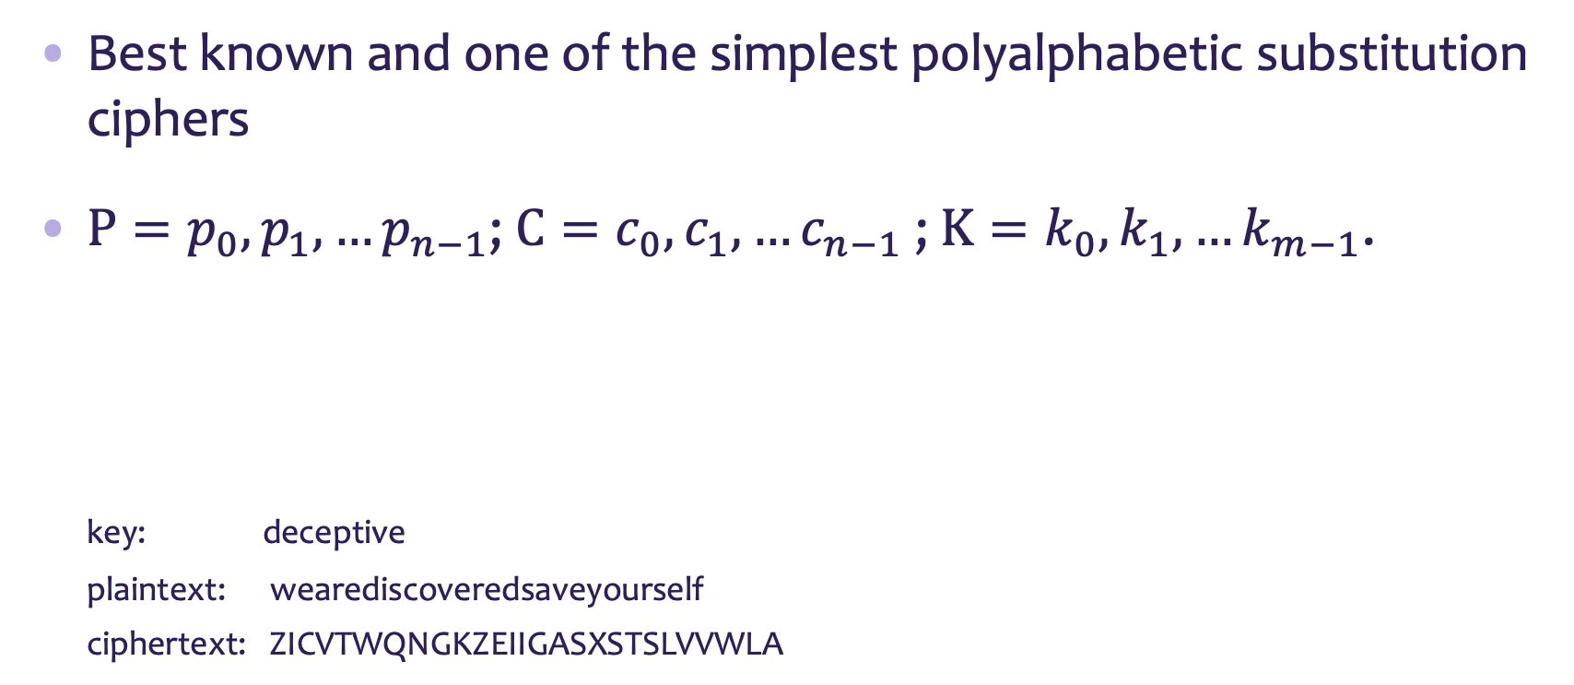
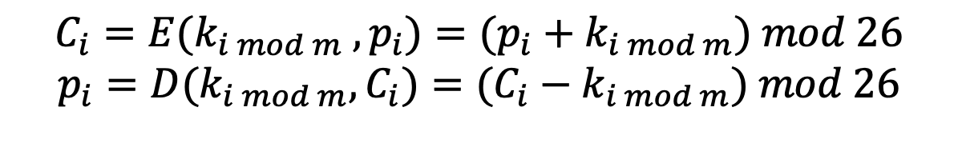
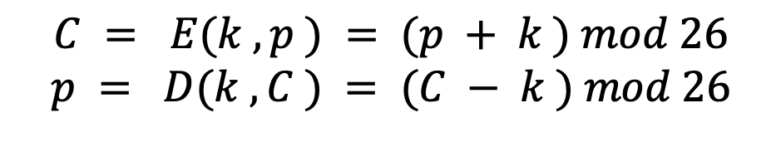
Vigenère Cipher
Best known and one of the simplest polyalphabetic substitution ciphers
$P=p_{0},p_{1},…p_{n−1}$; $C=c_{0},c_{1},…c_{n−1}$ ; $K=k_{0},k_{1},…k_{m−1}$.
key: deceptive
plaintext: wearediscoveredsaveyourself
ciphertext: ZICVTWQNGKZEIIGASXSTSLVVWLA
Caesar Cipher
Vigenère Cipher
$$C = E(k , p ) = (p + k ) mod 26$$
$$p = D(k , C ) = (C − k ) mod 26$$
$$C_{i}=E(k_{i mod m} , p_{i})=(p_{i}+k_{i mod m}) mod 26$$
$$p_{i}=D(k_{i mod m},C_{i})=(C_{i}−k_{i mod m}) mod 26$$
Notes:
The best known, and one of the simplest, polyalphabetic ciphers
is the Vigenère cipher. In this scheme, the set of related monoalphabetic substitution
rules consists of the 26 Caesar ciphers with shifts of 0 through 25. Each cipher is
denoted by a key letter, which is the ciphertext letter that substitutes for the plaintext
letter a. Thus, a Caesar cipher with a shift of 3 is denoted by the key value 3.

Slide 34
Vigenère Autokey System
A keyword is concatenated with the plaintext itself to provide a running key
Example:
key: deceptivedeceptivedeceptive
plaintext: wearediscoveredsaveyourself
ciphertext: ZICVTWQNGKZEIIGASXSTSLVVWLA
Even this scheme is vulnerable to cryptanalysis
Because the key and the plaintext share the same frequency distribution of letters, a statistical technique can be applied
Notes:
The periodic nature of the keyword can be eliminated by using a nonrepeating
keyword that is as long as the message itself. Vigenère proposed what is referred to
as an autokey system , in which a keyword is concatenated with the plaintext itself to
provide a running key. For our example,
key: deceptivewearediscoveredsav
plaintext: wearediscoveredsaveyourself
ciphertext: ZICVTWQNGKZEIIGASXSTSLVVWLA
Even this scheme is vulnerable to cryptanalysis. Because the key and the
plaintext share the same frequency distribution of letters, a statistical technique
can be applied. For example, e enciphered by e , by Figure 3.5, can be expected to
occur with a frequency of (0.127⁾² = 0.016, whereas t enciphered by t would occur
only about half as often. These regularities can be exploited to achieve successful
cryptanalysis.

Slide 35
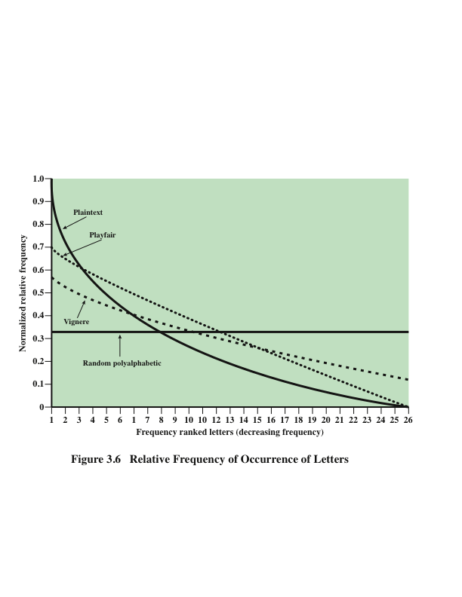
Notes:
One way of revealing the effectiveness of the Playfair and other ciphers
is shown in Figure 3.6. The line labeled plaintext plots a typical frequency
distribution of the 26 alphabetic characters (no distinction between upper
and lower case) in ordinary text. This is also the frequency distribution of any
monoalphabetic substitution cipher, because the frequency values for individual
letters are the same, just with different letters substituted for the original letters.
The plot is developed in the following way: The number of occurrences of each
letter in the text is counted and divided by the number of occurrences of the
most frequently used letter. Using the results of Figure 3.5, we see that
e is the most frequently used letter. As a result, e has a relative frequency of 1, t of
9.056/12.702 0.72, and so on. The points on the horizontal axis correspond
to the letters in order of decreasing frequency.
Figure 3.6 also shows the frequency distribution that results when the text
is encrypted using the Playfair cipher. To normalize the plot, the number of
occurrences of each letter in the ciphertext was again divided by the number of
occurrences of e in the plaintext. The resulting plot therefore shows the extent
to which the frequency distribution of letters, which makes it trivial to solve
substitution ciphers, is masked by encryption. If the frequency distribution
information were totally concealed in the encryption process, the ciphertext plot
of frequencies would be flat, and cryptanalysis using ciphertext only would be
effectively impossible. As the figure shows, the Playfair cipher has a flatter distribution
than does plaintext, but nevertheless, it reveals plenty of structure for
a cryptanalyst to work with. The plot also shows the Vigenère cipher, discussed
subsequently. The Hill and Vigenère curves on the plot are based on results
reported in [SIMM93].

Slide 36


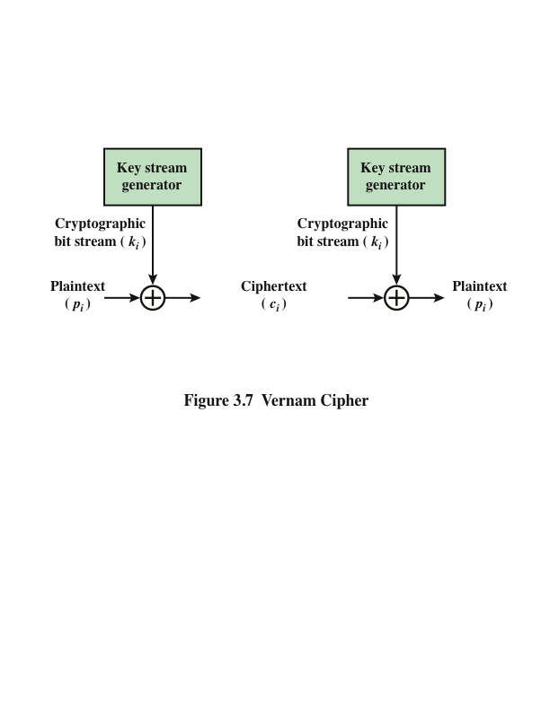
Vernam Cipher
Stream Cipher
This system works on binary data rather than letters.
$$c_{i}=p_{i}⨁k_{i}$$
$$p_{i}=c_{i}⨁k_{i}$$
Notes:
The ultimate defense against such a cryptanalysis is to choose a
keyword that is as long as the plaintext and has no statistical relationship to it. Such
a system was introduced by an AT&T engineer named Gilbert Vernam in 1918.
His system works on binary data (bits) rather than letters.
The essence of this technique is the means of construction of the key. Vernam
proposed the use of a running loop of tape that eventually repeated the key, so
that in fact the system worked with a very long but repeating keyword. Although
such a scheme, with a long key, presents formidable cryptanalytic difficulties, it
can be broken with sufficient ciphertext, the use of known or probable plaintext
sequences, or both.

Slide 37
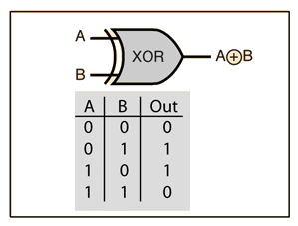


XOR Operations
Why Enc & Dec the same operation?
XOR operations = mod 2
Mod 2 addition and subtraction are the same operation
$$c_{i}=p_{i}⨁k_{i}$$
$$p_{i}=c_{i}⨁k_{i}$$
Example:
Encryption of ASCII “A” (Decimal : 65, Binary: 1000001). K = 0101101.
P = 1000001 C = 1101100
K = 0101101 K = 0101101
C = 1101100 P = 1000001

Slide 38
Summary
Extended Euclidean Algorithm
Modular inverse
Cryptology
Cryptography
Cryptanalysis
Understand the operation of a monoalphabetic substitution cipher
Understand the operation of a polyalphabetic cipher
Introduce basic stream cipher
Notes:
Chapter 3 summary.

